Slide 1
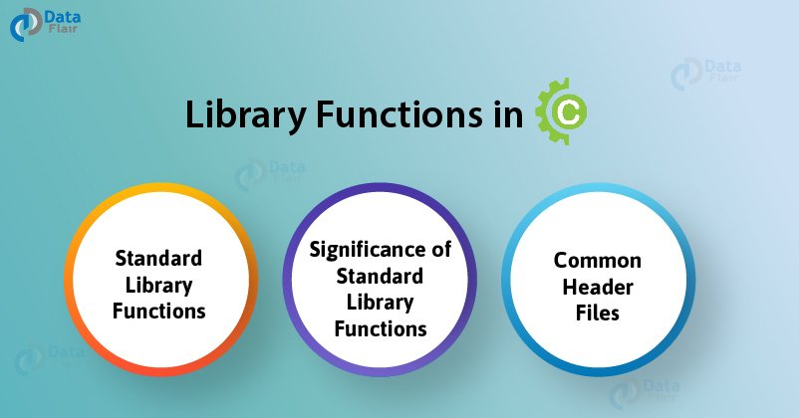
Team A
Hesenova Firuze & Eliyeva Ilahe

Slide 2
G
1. Standard Library Functions in C
Standard Library Functions are basically the inbuilt functions in the C compiler that makes things easy for the programmer.
As we have already discussed, every C program has at least one function, that is, the main() function. The main() function is also a standard library function in C since it is inbuilt and conveys a specific meaning to the C compiler.
2. Significance of Standard Library Functions in C
2.1 Usability
Standard library functions allow the programmer to use the pre-existing codes available in the C compiler without the need for the user to define his own code by deriving the logic to perform certain basic functions.

Slide 3
2.2 Flexibility
A wide variety of programs can be made by the programmer by making slight modifications while using the standard library functions in C.
2.3 User-friendly syntax
We have already discussed in Function in C tutorial that how easy it is to grasp and use the syntax of functions.
2.4 Optimization and Reliability
All the standard library functions in C have been tested multiple times in order to generate the optimal output with maximum efficiency making it reliable to use.
2.5 Time-saving
Instead of writing numerous lines of codes, these functions help the programmer to save time by simply using the pre-existing functions.
2.6 Portability
Standard library functions are available in the C compiler irrespective of the device you are working on. These functions connote the same meaning and hence serve the same purpose regardless of the operating system or programming environment.
3. Header Files in C
In order to access the standard library functions in C, certain header files need to be included before writing the body of the program.
Don’t move further, if you are not familiar with the Header Files in C.
Here is a tabular representation of a list of header files associated with some of the standard library functions in C:

Slide 4
HEADER FILE | MEANING | ELUCIDATION
<stdio.h> | Standard input-output header | Used to perform input and output operations like scanf() and printf().
<string.h> | String header | Used to perform string manipulation operations like strlen and strcpy.
<conio.h> | Console input-output header | Used to perform console input and console output operations like clrscr() to clear the screen and getch() to get the character from the keyboard.
<stdlib.h> | Standard library header | Used to perform standard utility functions like dynamic memory allocation using functions such as malloc() and calloc().
<math.h> | Math header | Used to perform mathematical operations like sqrt() and pow() to obtain the square root and the power of a number respectively.
<ctype.h> | Character type header | Used to perform character type functions like isaplha() and isdigit() to find whether the given character is an alphabet or a digit. respectively.

Slide 5
<time.h> | Time header | Used to perform functions related to date and time like setdate() and getdate() to modify the system date and get the CPU time respectively.
<assert.h> | Assertion header | Used in program assertion functions like assert() to get an integer data type as a parameter which prints stderr only if the parameter passed is 0.
<locale.h> | Localization header | Used to perform localization functions like setlocale() and localeconv() to set locale and get locale conventions respectively.

Slide 6
signal.h> | Signal header | Used to perform signal handling functions like signal() and raise() to install signal handler and to raise the signal in the program respectively.
<setjmp.h> | Jump header | Used to perform jump functions.
<stdarg.h> | Standard argument header | Used to perform standard argument functions like va_start and va_arg() to indicate the start of the variable-length argument list and to fetch the arguments from the variable-length argument list in the program respectively.
<errno.h> | Error handling header | Used to perform error handling operations like errno() to indicate errors in the program by initially assigning the value of this function to 0 and then later changing it to indicate errors.

Slide 7
3.1 <stdio.h>
This is the basic header file used in almost every program written in the C language. It stands for standard input and standard output used to perform input-output functions, some of which are:
printf()– Used to display output on the screen.
scanf()– To take input from the user.
getchar()– To return characters on the screen.
putchar()– To display output as a single character on the screen.
fgets()– To take a line as an input.
puts()– To display a line as an output.
fopen()– To open a file.
fclose()– To close a file.

Slide 8
3.3 <stdlib.h>
Functions such as malloc(), calloc(), realloc() and free() can be used while dealing with dynamic memory allocation of variables.
Let us learn these 4 basic functions before using them in our program.
It should be clear that these functions are used for dynamic memory allocation of variables, that is in contrast to arrays that allocate memory in a static (fixed) manner.
3.3.1 malloc()
malloc() stands for memory allocation. This function is responsible for reserving a specific block of memory and returns a null pointer during the execution of the program.

Slide 9
3.3.2 calloc()
calloc stands for contiguous allocation. It is similar to malloc in all respects except the fact that it initializes the memory to 0 and has the ability to allocate numerous blocks of memory before the execution of the program.
pointer_name = (cast_type*) calloc (no_of_bytes, size_of_cast_type);

Slide 10
3.3.3 realloc()
realloc stands for reallocation. It is used to change the size of the previously allocated memory in case the previously allocated memory is insufficient to meet the required needs of the variable in C.
pointer_name = realloc(pointer_name, new_size);
3.3.4 free()
free is responsible to free the dynamically allocated memory done by malloc(), calloc() or realloc() to the system.
free( pointer_name );

Slide 11
3.4 <math.h>
The math header is of great significance as it is used to perform various mathematical operations such as:
sqrt() – This function is used to find the square root of a number
pow() – This function is used to find the power raised to that number.
fabs() – This function is used to find the absolute value of a number.
log() – This function is used to find the logarithm of a number.
sin() – This function is used to find the sine value of a number.
cos() – This function is used to find the cosine value of a number.
tan() – This function is used to find the tangent value of a number.

Slide 12
3.5 <ctype.h>
This function is popularly used when it comes to character handling.
Some of the functions associated with <ctype.h> are:
isalpha() – Used to check if the character is an alphabet or not.
isdigit() – Used to check if the character is a digit or not.
isalnum() – Used to check if the character is alphanumeric or not.
isupper() – Used to check if the character is in uppercase or not
islower() – Used to check if the character is in lowercase or not.
toupper() – Used to convert the character into uppercase.
tolower() – Used to convert the character into lowercase.
iscntrl() – Used to check if the character is a control character or not.
isgraph() – Used to check if the character is a graphic character or not.
isprint() – Used to check if the character is a printable character or not
ispunct() – Used to check if the character is a punctuation mark or not.
isspace() – Used to check if the character is a white-space character or not.
isxdigit() – Used to check if the character is hexadecimal or not.
<ctype.h> is not supported in Linux but it works fairly well in Microsoft Windows.

Slide 13
3.6 <conio.h>
It is used to perform console input and console output operations like clrscr() to clear the screen and getch() to get the character from the keyboard.
Note: The header file <conio.h> is not supported in Linux. It works fairly well on Microsoft Windows.

